Slide 1
STAT 390 Final Presentation
Akhil, David, Harvey, Jeffrey, Veer

Slide 2
Testing Methodology

Slide 3
Model Testing Framework
Begin with base pre-trained network
Train models on a per-stain basis
Tune learning rate + number epochs until consistent convergence is reached
Use model evaluation + model architecture to identify hyperparameters to manipulate
Evaluate model on:
Patch-wise recall (By stain)
Case-wise recall (By stain w/ SVC top-k classifier)
Case-wise recall (By ensembling stains w/ SVC top-k classifier)

Slide 4
KimiaNet

Slide 5
Memory Constraint Solutions
Resizing
Small batch sizes
Downsides:
Noisy and high-variance gradient estimates
May hurt BatchNorm effectiveness
BatchNorm normalizes the input of each layer to have mean = 0, std. dev. = 1
Reduces the change in layer input distributions during training and leads faster training and more stable gradients
Replace BatchNorm with GroupNorm:
Divides the channels of a feature map into groups, then normalizes within each group
Mixed Precision
We use 32-bit floats for important calculations, use 16-bit for others

Slide 6
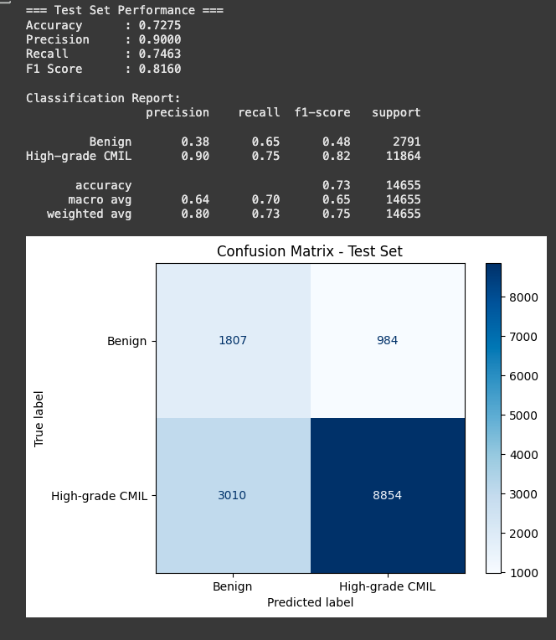
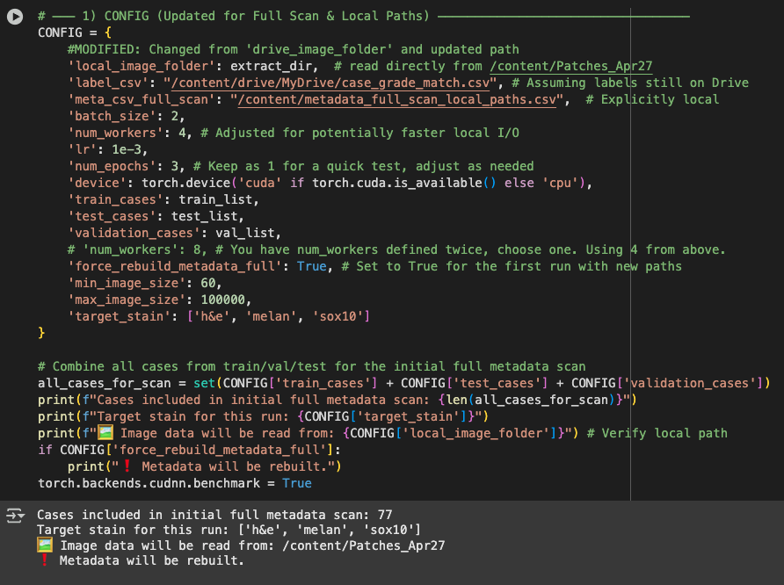
KimiaNet – resize, all stains
Case-level (SVM): all cases predicted as High-grade

Slide 7
KimiaNet Ensembling Workflow
Trained a KimiaNet model for each stain
Ensemble the best models for each stain using
Majority voting
Akhil’s SVM

Slide 8
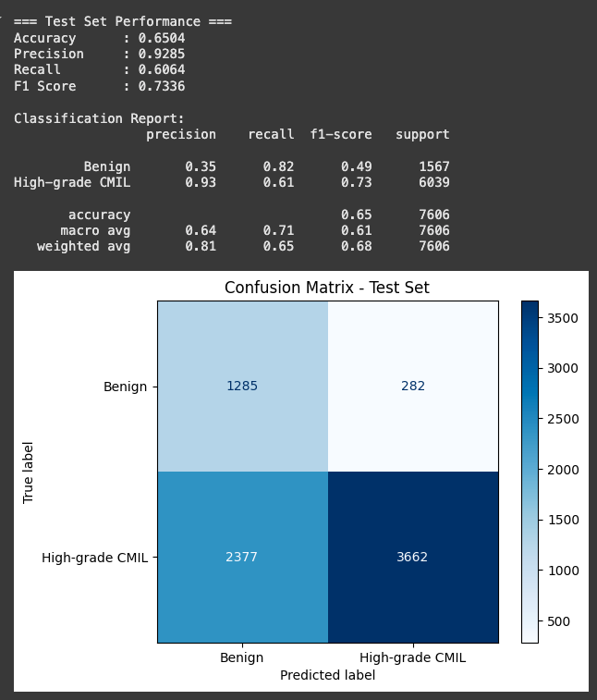
KimiaNet – H&E AdaPool
With threshold Sweep (0.22):
Benign Recall: 0.704
High-Grade Recall: 0.738

Slide 9
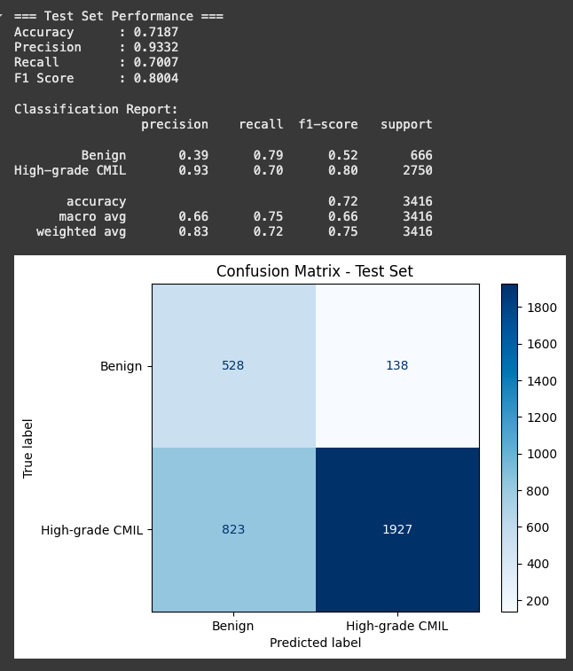
KimiaNet - SOX10 AdaPool
With threshold Sweep (0.22):
Benign Recall: 0.704
High-Grade Recall: 0.778

Slide 10
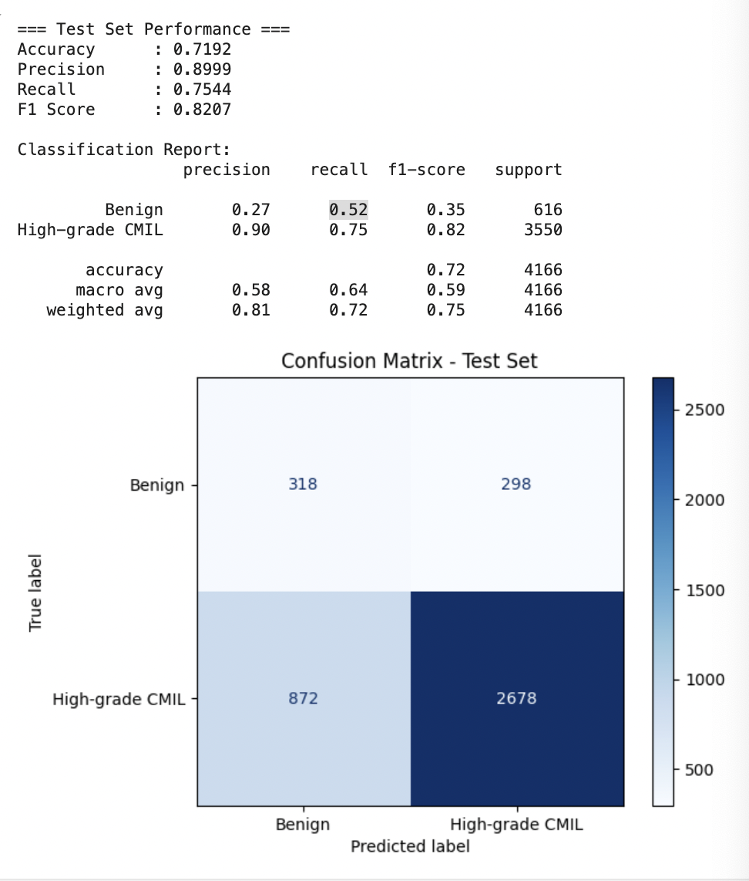
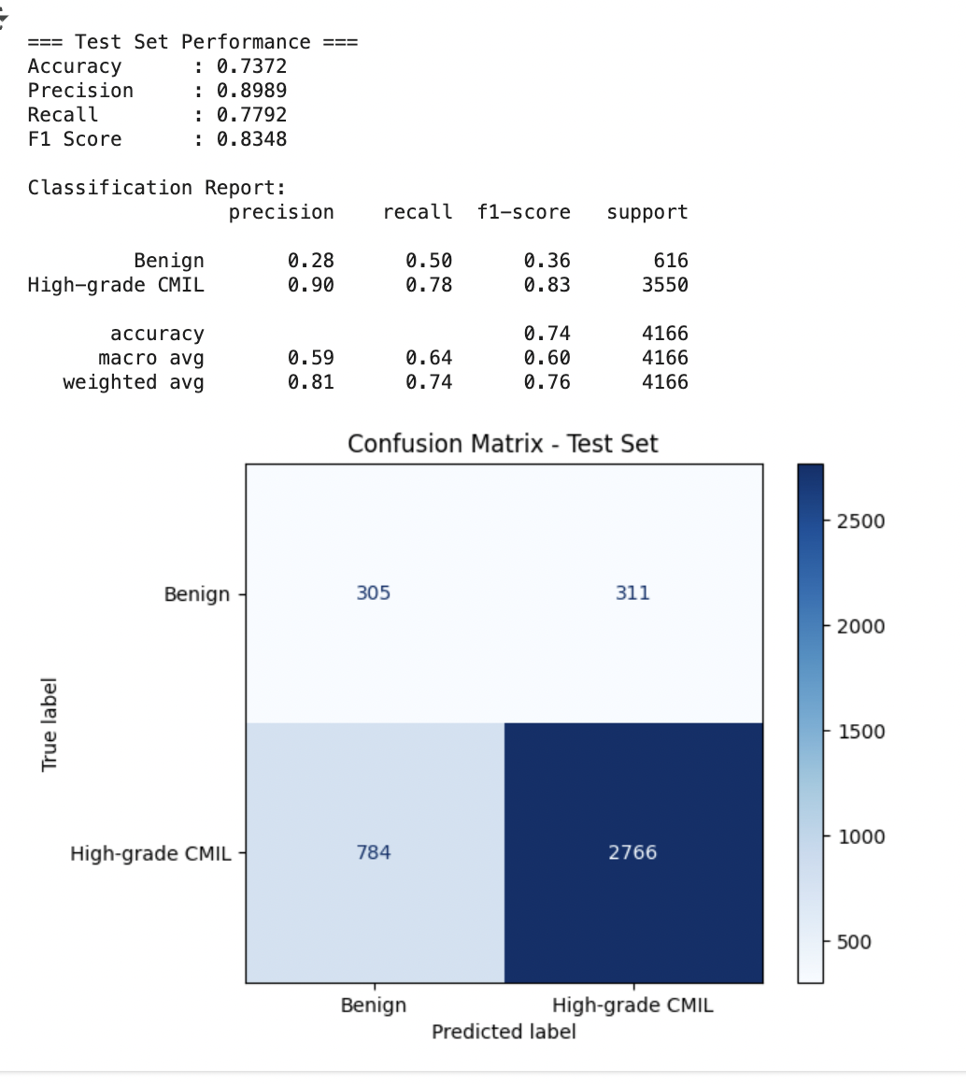
KimiaNet melan: Hyperparam optimization (Colab)
batch_size = 2 | lr = 0.001 | Epochs = 3| Class weighting
batch_size = 2 | lr = 0.001 | Epochs = 3

Slide 11
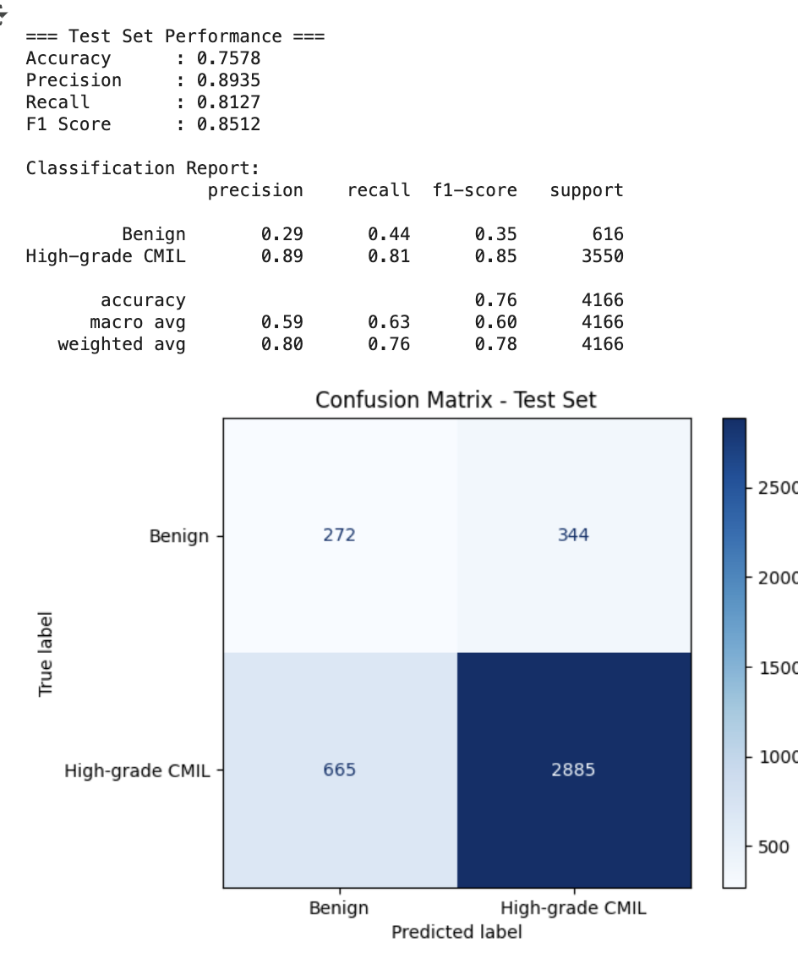
AdaPool KimiaNet: melan
batch_size = 2 | lr = 0.001 | Epochs = 3| 2x Class weighting| Dropout = 0.5 |Threshold Sweep
Without threshold Sweep:
With threshold Sweep:
Benign Recall: 0.60
High-Grade Recall: 0.71

Slide 12
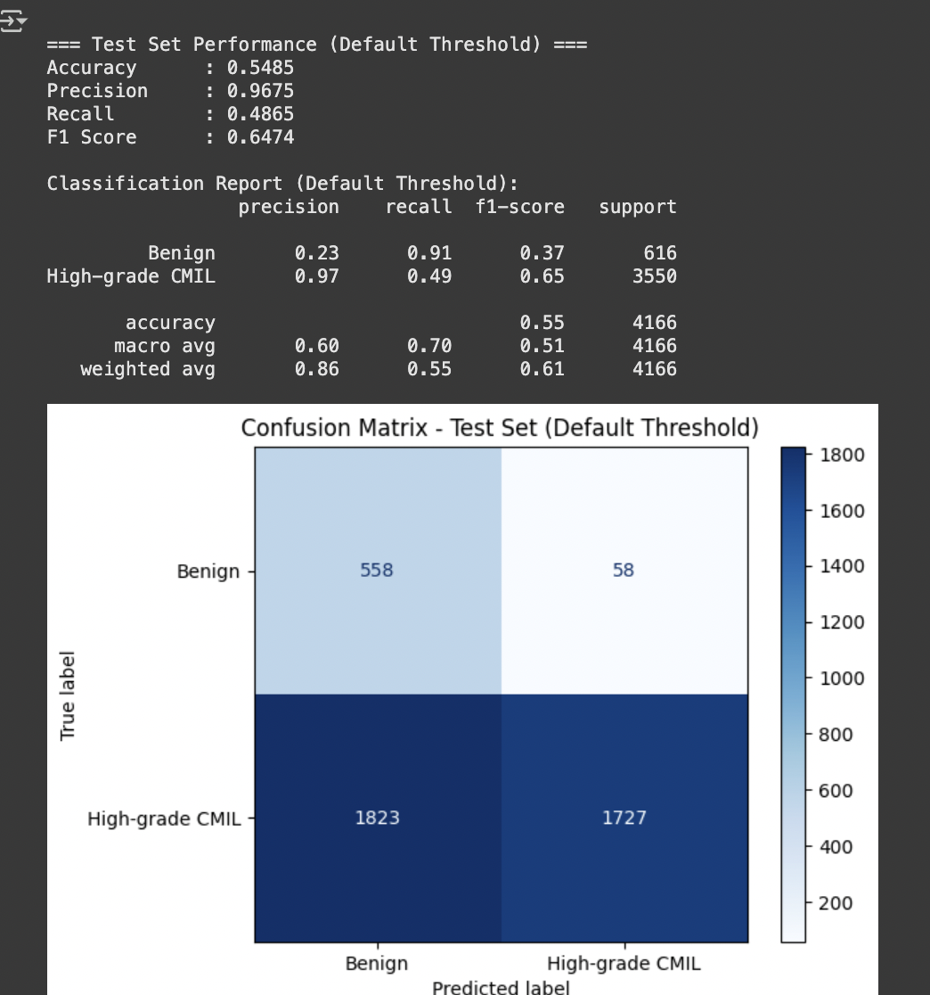
BEST AdaPool KimiaNet: melan
batch_size = 2 | lr = 0.001 | Epochs = 3| 4x Class weighting| Dropout = 0.25 |Focal Loss |Threshold Sweep
Without threshold Sweep:
With threshold Sweep:
Benign Recall: 0.62
High-Grade Recall: 0.735

Slide 13
KimiaNet Ensembling

Slide 14
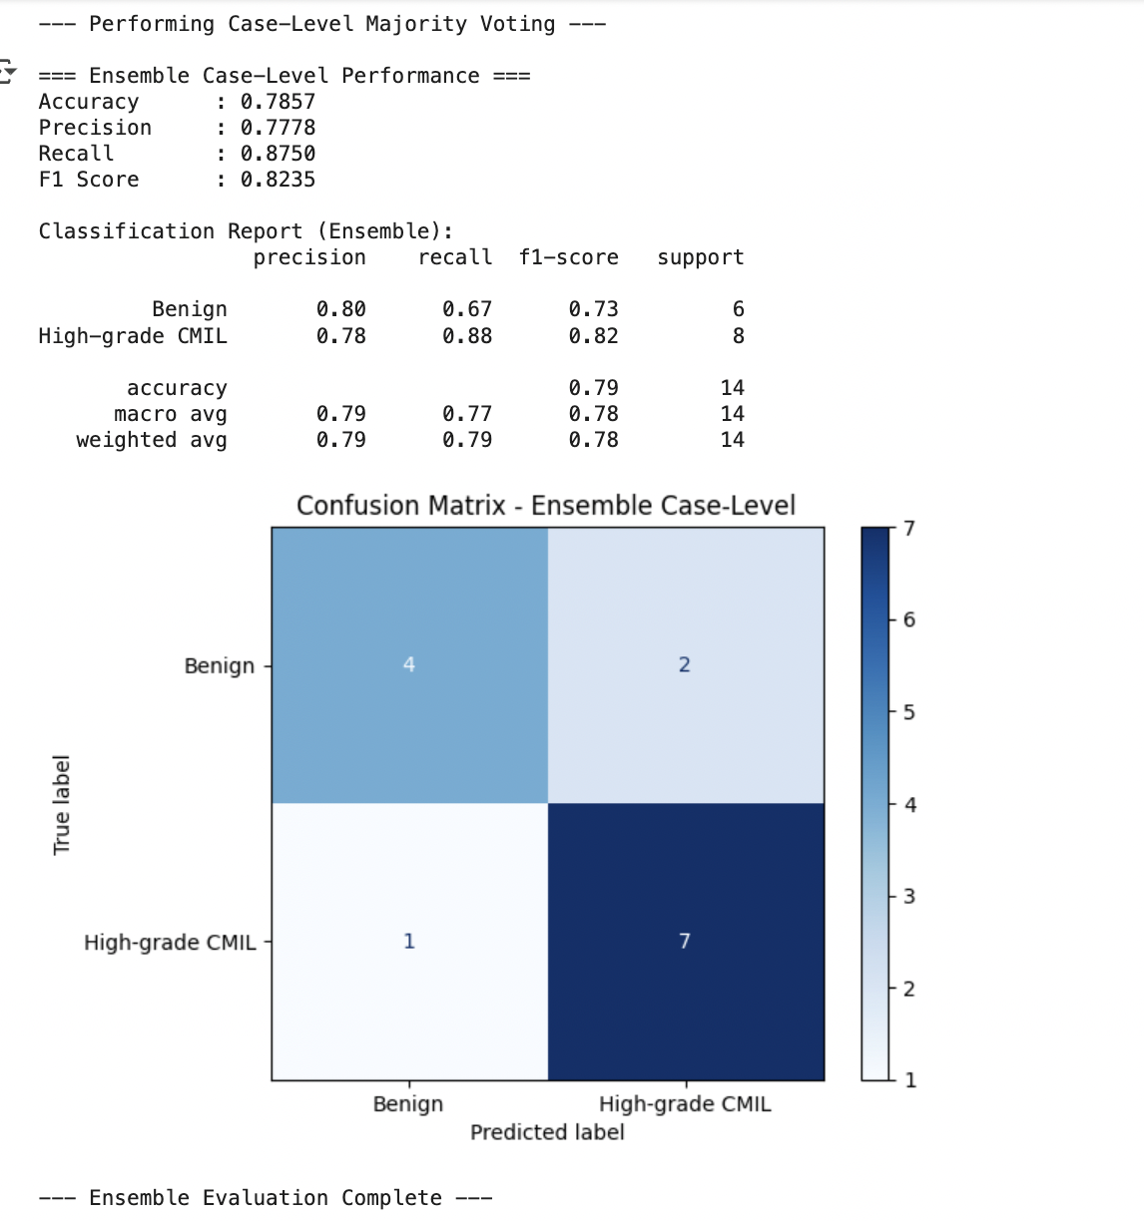
KimiaNet Stain Ensemble with Majority Voting
batch_size = 2 | lr = 0.001 | Epochs = 3|Threshold Sweep | 4x Class weighting for melan | Dropout = 0.25 for melan |Focal Loss for melan

Slide 15
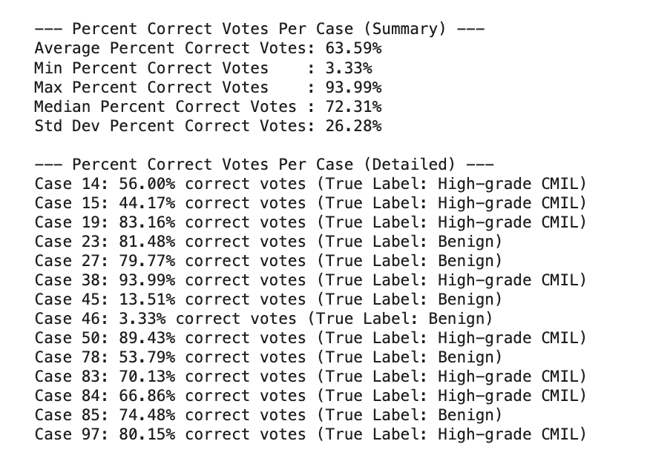
KimiaNet Ensemble Majority Voting: Within-Case Voting Accuracy
Case-Level Voting Accuracy
Median: 72.31%
Mean: 63.59%
For correct cases
Median: 79.77%
Mean: 75.39%
For incorrect cases
Median = 13.51%
Mean = 20.34
Notes:
53, 56, 66, 70, 74, 79, 80, 81, 83, 89, 93,

Slide 16
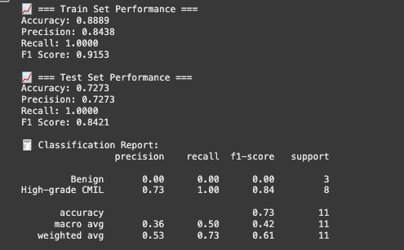
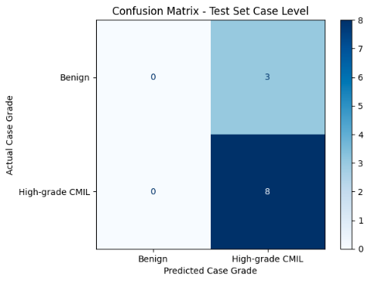
KimiaNet Ensembling with SVM

Slide 17
AlexNet

Slide 18
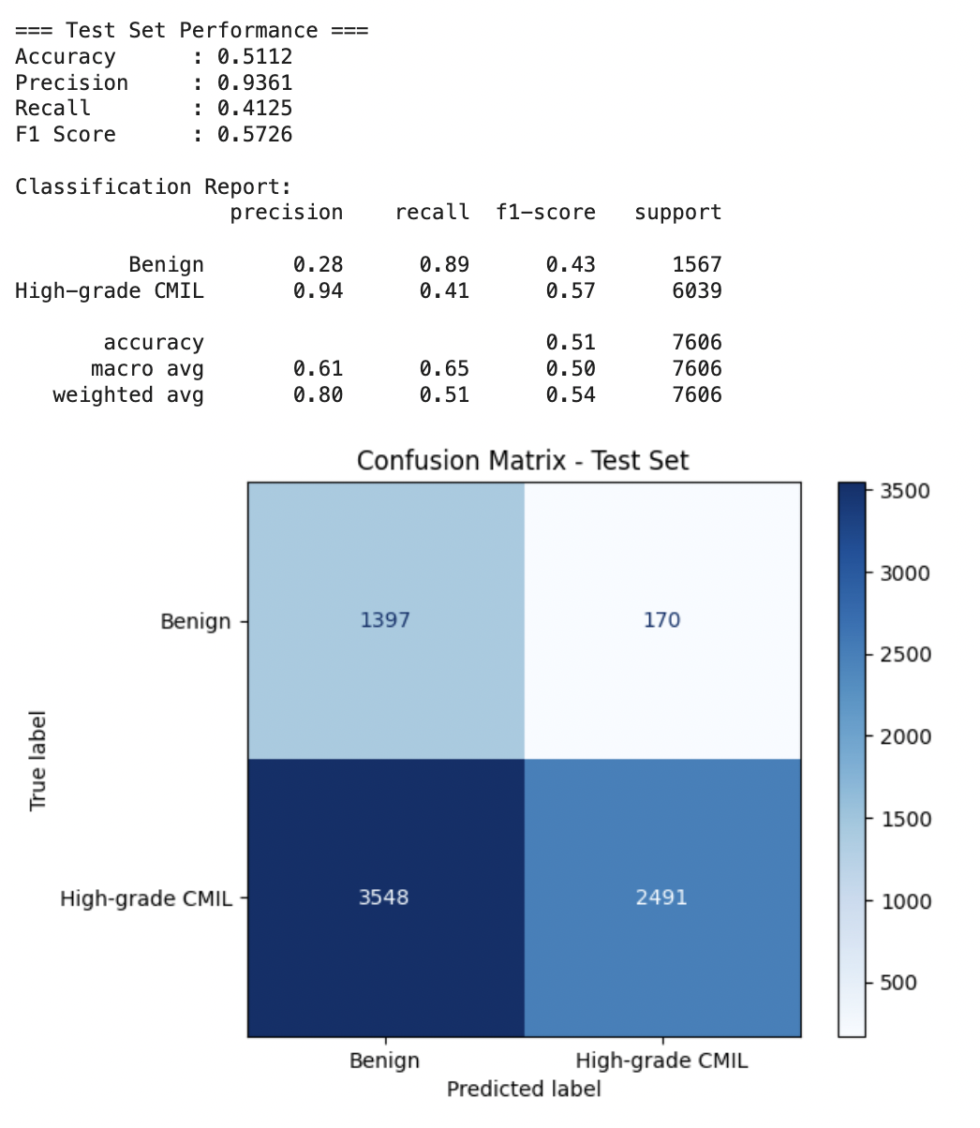
AlexNet Best Performance (h&e)
Could be improved with threshold sweep, but worse than KimiaNet
Tried these but unsuccessful
Class weighting
Threshold tuning
Early stopping
Gradient accumulation (higher batch size w/o more memory)
Gradients calculated for every batch, but weights only updated after every n batches
L2 regularization
Penalizes big weights
Learning rate scheduler
Slows learning rate over time

Slide 19
DeIT

Slide 20
DeIT Visual Transformer Models
Transformer Architecture: Uses self-attention mechanism to process image
Patch-based Processing: Images are divided into fixed-size patches, which are then linearly embedded and fed into the transformer encoder
Positional Embeddings: Transformers rely on positional embeddings which are learned for a fixed maximum sequence length. If the input size varies, the number of patches changes, disrupting the learned positional information
Self-Attention Mechanism: The dimensions of the input matrices need to be fixed
Learnable Embeddings and Weights: The linear projection layers embed the image patches into the latent space
Changing the size of inputs would require re-sizing or re-learning these parameters

Slide 21
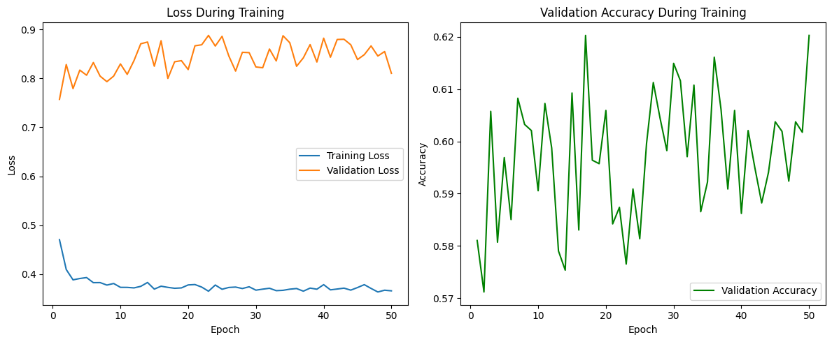
Finding Convergence
Base Skeleton Code DeIT Model
H&E

Slide 22
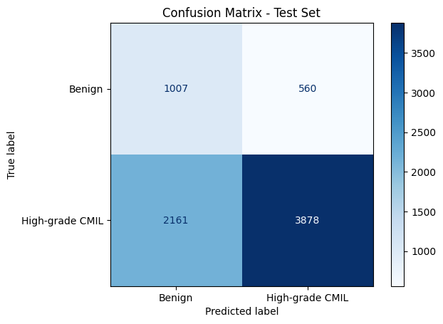
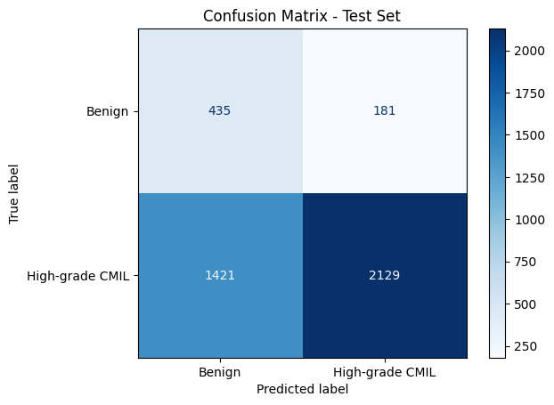
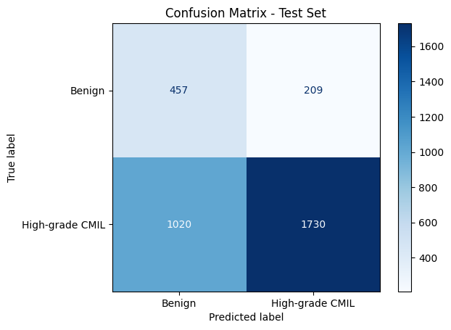
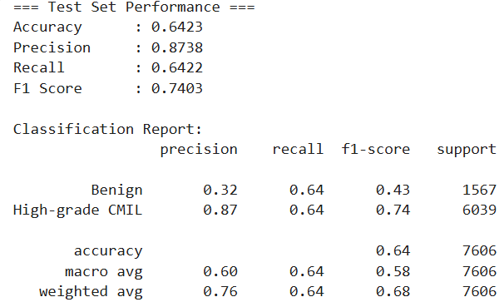
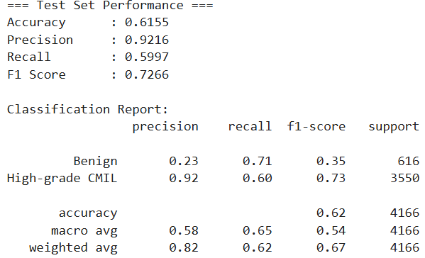
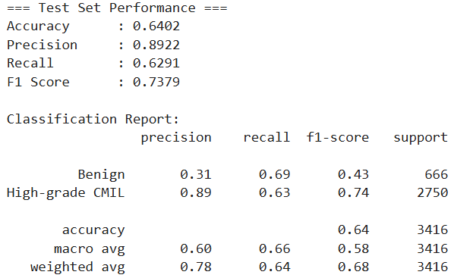
Base Model (everything in the skeleton) Performance

Slide 23

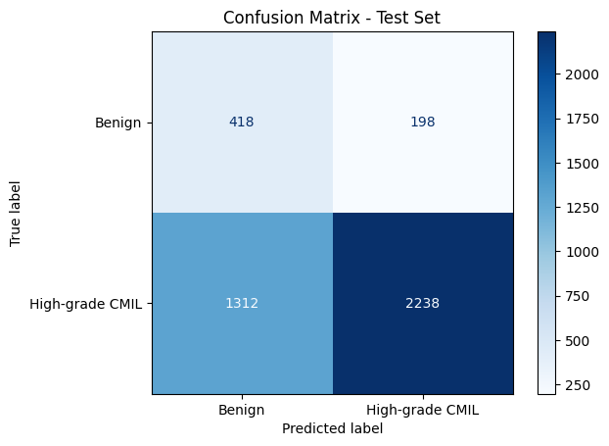
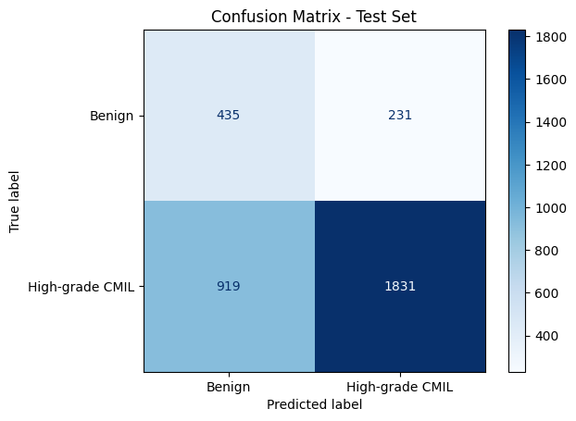
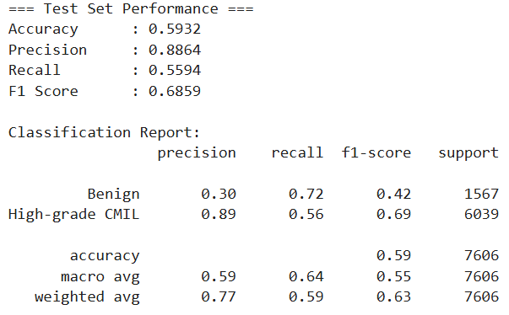
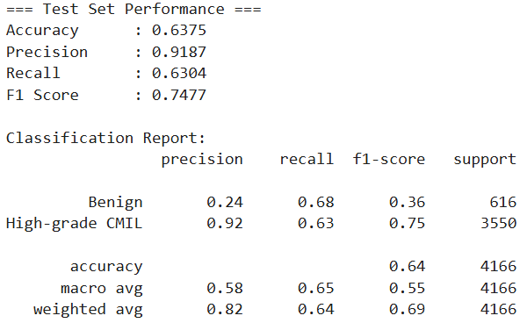
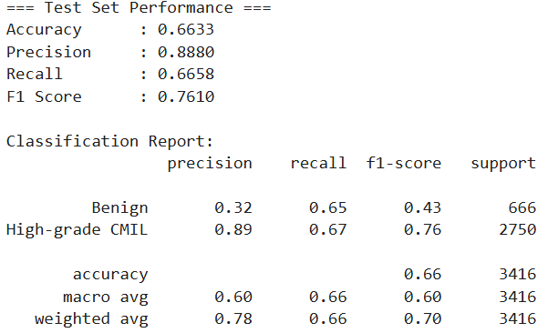
Base Model Without Class Weights Performance

Slide 24



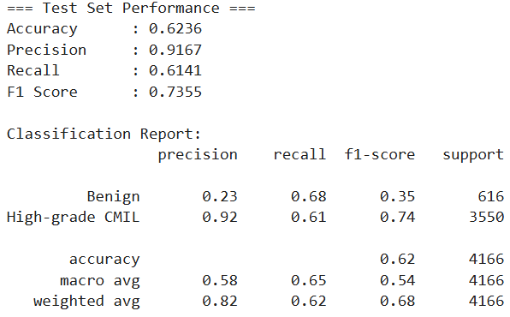
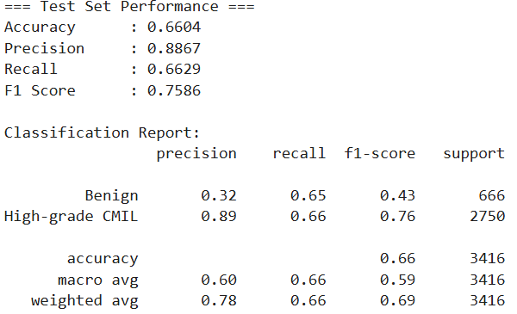
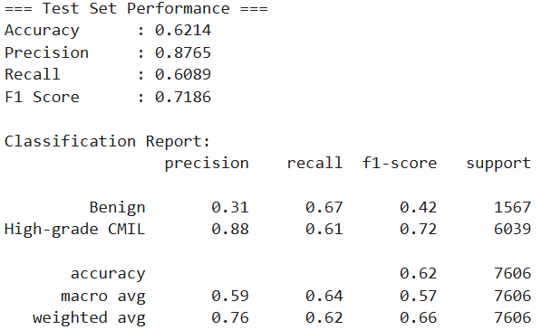
Best Performing with L2 Weight Regularization

Slide 25

CutMix Data Augmentation
Combines images and their respective labels to create training examples:
Inside a batch, random rectangles are cut from one patch and pasted onto another patch
The labels for the mixed image are adjusted proportionally to the area of the pasted region
Calculate cross entropy twice

Slide 26



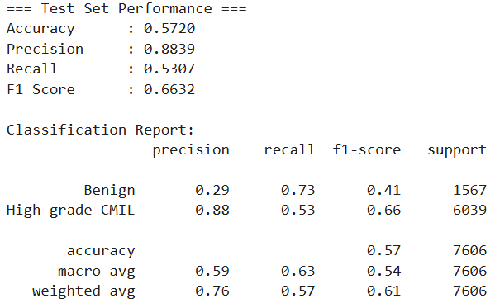
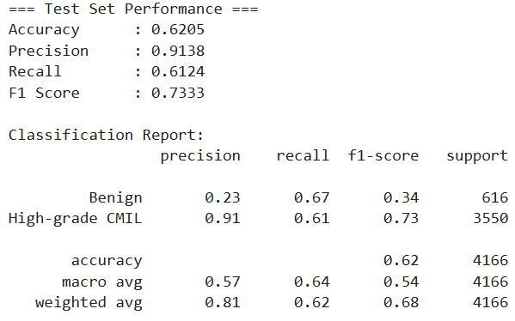
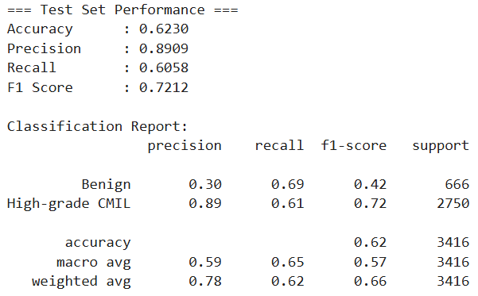
Best Performing With CutMix Augmentation Performance

Slide 27
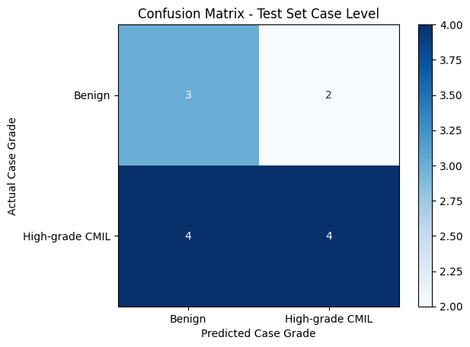
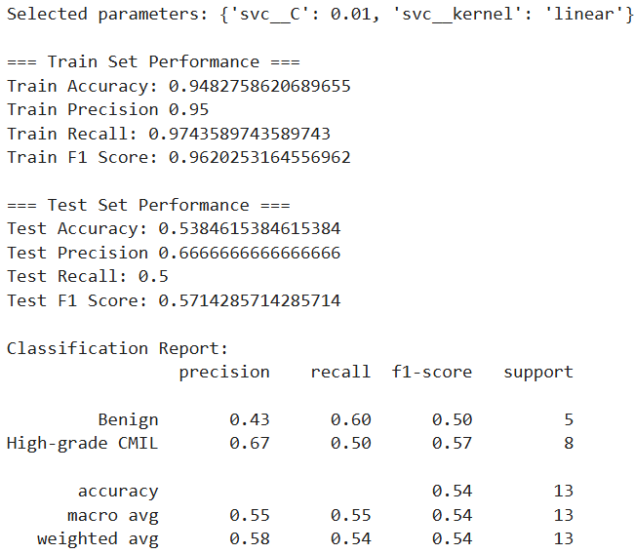
Final Ensemble Performance
H&E: Balanced Weights, L2 Regularization, CutMix
Melan: Unbalanced Weights, CutMix
Sox: Unbalanced Weights

Slide 28
CoAtNet

Slide 29
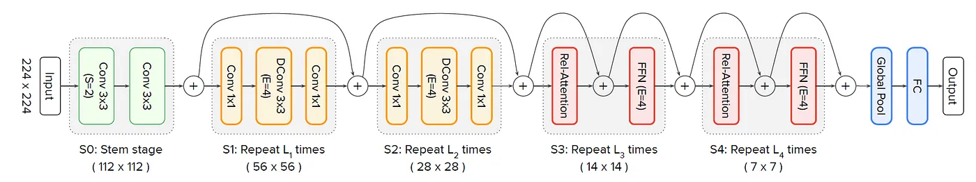
CoAtNet Architecture
CoAtNet proceeds through four primary stages/blocks
S1/S2: MBConv Blocks - Expands then narrows images to identify local spatial patterns
S3/S4: Transformer Blocks (Relative Attention) - Uses attention to identify global patterns
Trained on ImageNet w/ 88.56% Top-1 Accuracy
Used in Boudjelal et al. 2024, Kvak 2022

Slide 30
CoAtNet Testing
Model: CoAtNet-0 (~25M Params) vs. CoAtNet-2 (~75M Params)
Regularization: Drop_Path_Rate = 0 vs. Drop_Path_Rate = 0.3
Pooling at Classifier: Adaptive Pooling vs. Global Avg. Pooling

Slide 31
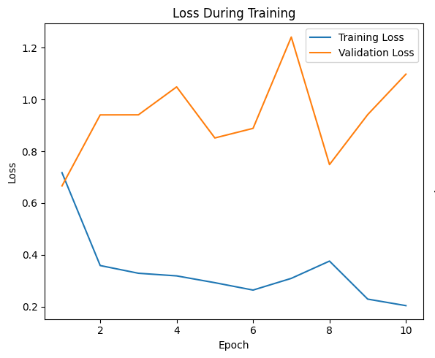
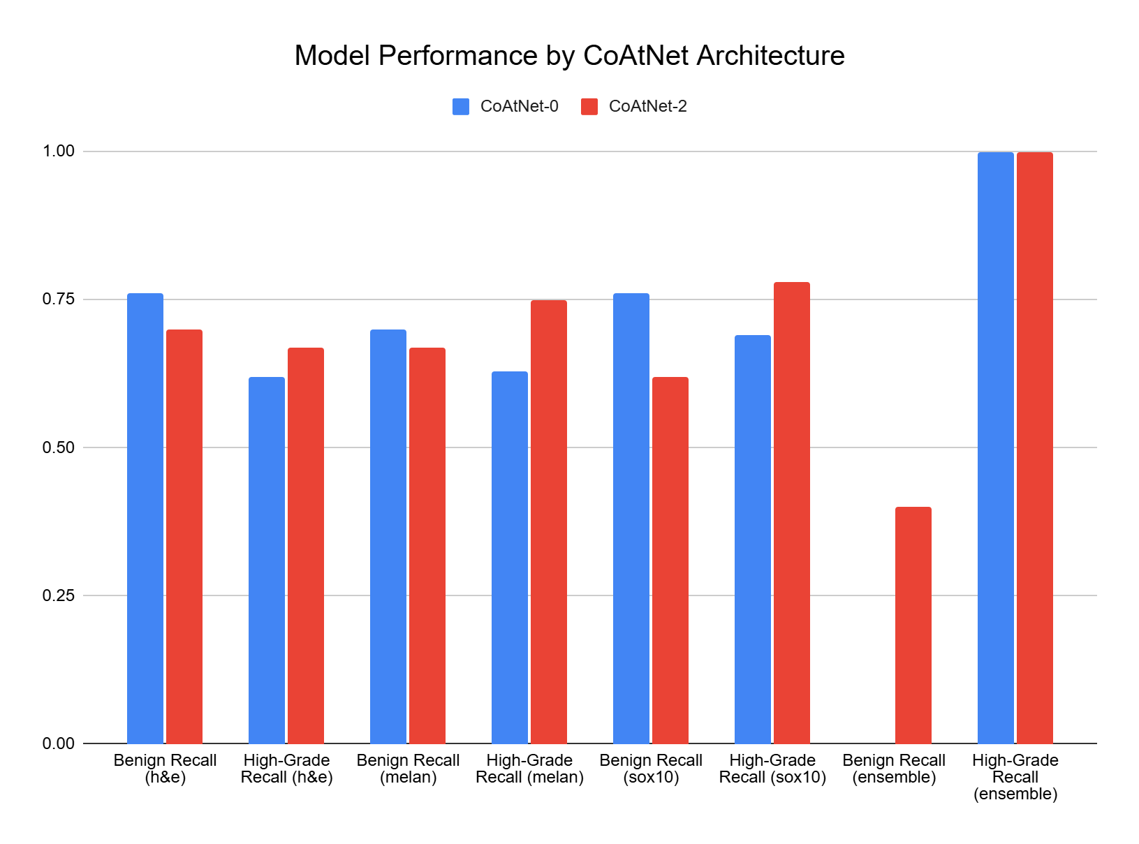
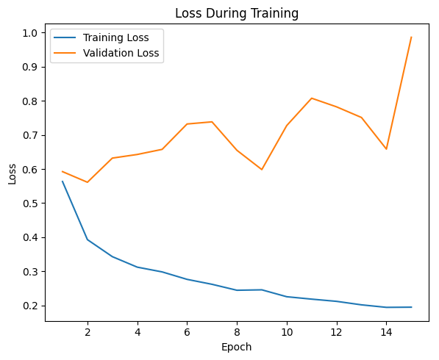
CoAtNet-0 vs. CoAtNet-2 Performance
CoAtNet-0
CoAtNet-2

Slide 32
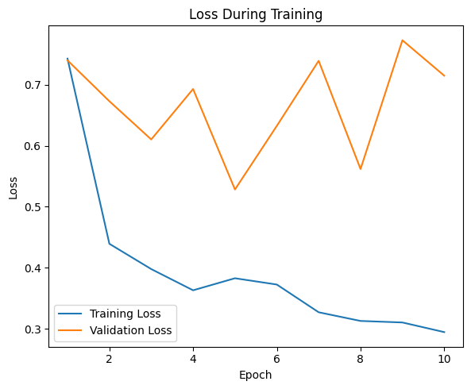
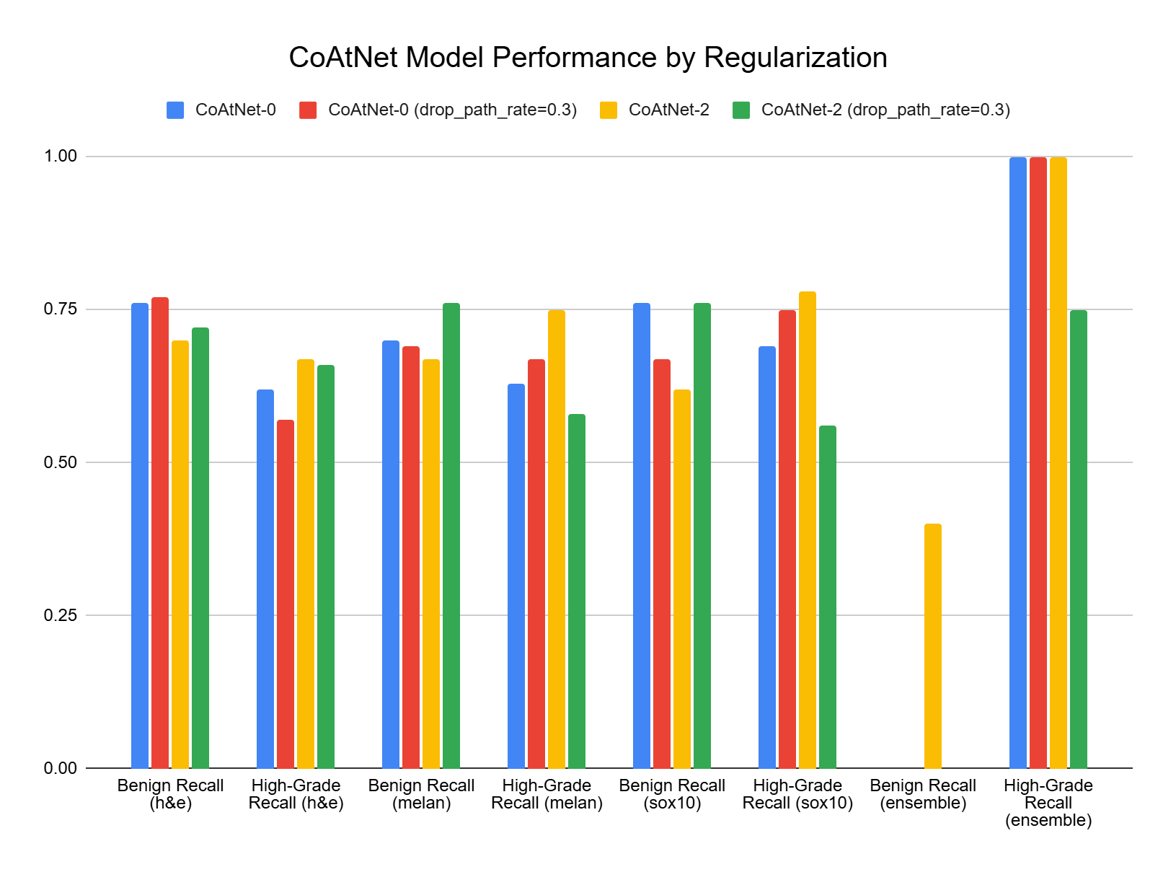
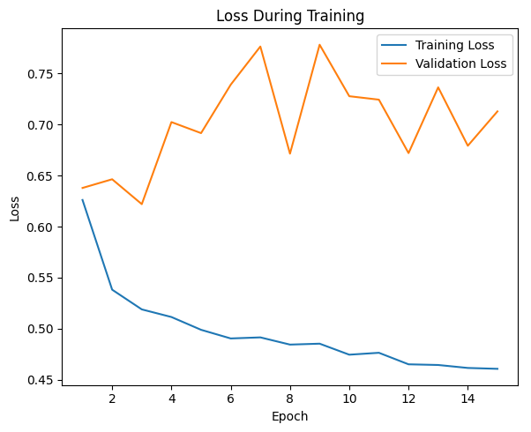
Impact of Regularization (drop_path_rate)
CoAtNet-0 (w/ Reg.)
CoAtNet-2 (w/ Reg.)

Slide 33
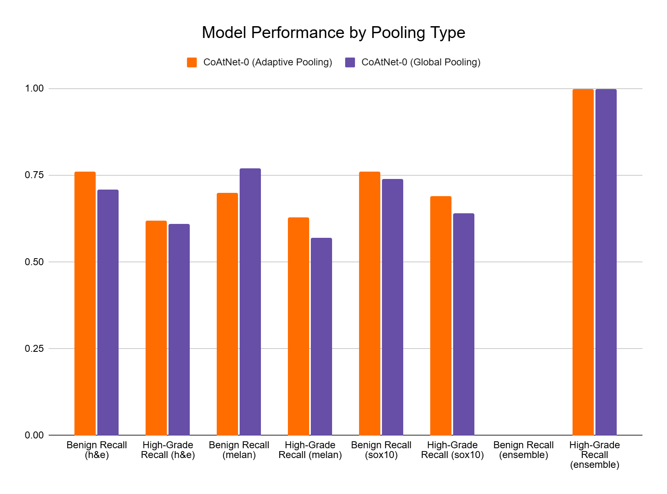
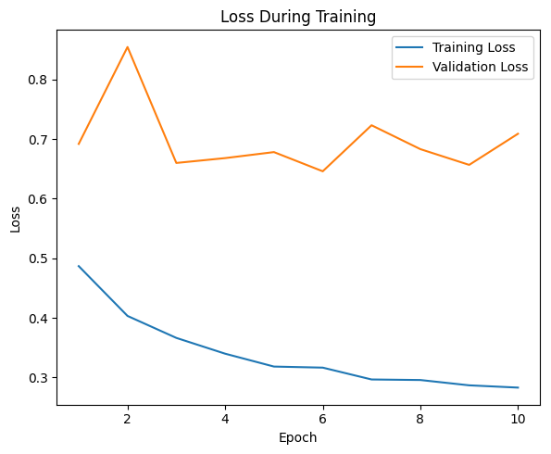
Adaptive vs. Global Pooling
CoAtNet-0 (AdaPool)
CoAtNet-0 (Global Pooling)

Slide 34
ResNet50

Slide 35
Takeaways/Next Steps

Slide 36
Conclusions
Key Takeaways:
Unclear of best current model: KimiaNet + CoAtNet-2 had relatively similar success
Maintain adaptive pooling, implement threshold sweep, use higher depth models w/ emphasis on methods to regularize models and prevent overfitting
Considerations/Potential Steps Moving Forward:
Unfreeze all layers, with L2 weight regularization
Attempt other Cutmix probability distributions
Case-level classifier considerations:
SVC Classifier would often only predict high-grade (Unsure if issue w/ classifier or models)
Optimal K-value can vary significantly based on model architecture
Majority voting classifier seems to work well
Should consider using Hipo-Map strategy from Kosaraju et al. 2022

Slide 37
Resources
Code:
Uploaded all model code to recreate models to the Github repository
Included ensemble_patch_level_pred.ipynb, which takes trained models and metadata by stain and ensembles w/ SVC for case-level predictions
Reference Papers:
DeIT original paper: https://arxiv.org/pdf/2012.12877
CoAtNet original paper: https://arxiv.org/pdf/2106.04803

